Slide 1

Embedded Systems, Cyber-Physical Systems and Robotics Final Project
Group 10
Tobias Coptil, Ngo Yan Abbie Fung, Mohamed Ali Gaoudi,
Mohamed Amine Jradi, Louisa Siebel, Sindi Teqja
Technical University of Munich
TUM School of Computation, Information and Technology
Campus Heilbronn, 20. August 2024
Notes:
1-2: louisa
3-6: abbie
7-9: louisa
10-13: sindi
14-15: dali
16-17: amine
18: abbie
19-22: dali
Rest: sindi

Slide 2
Table of Contents
Project Idea
Hardware & Software Needed
Methodologies & the Process
Testing
Final Demo Video
Conclusions

Slide 3
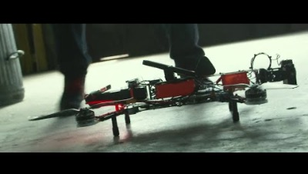
Project Idea
The insipration

Slide 4
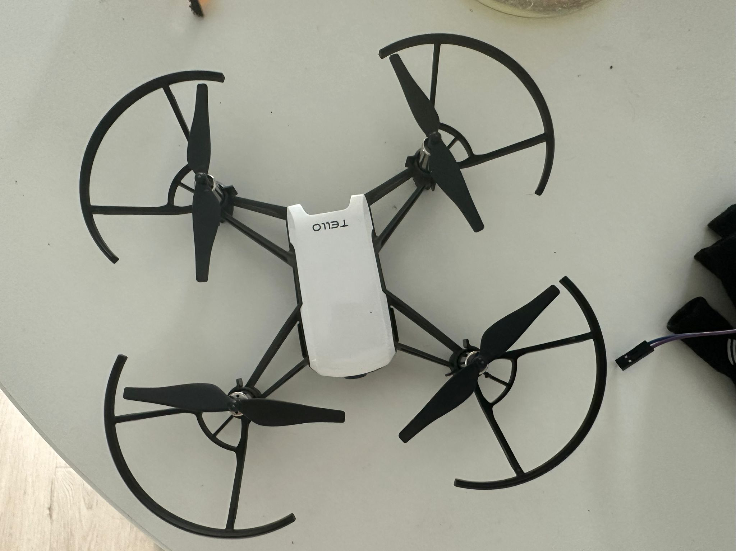
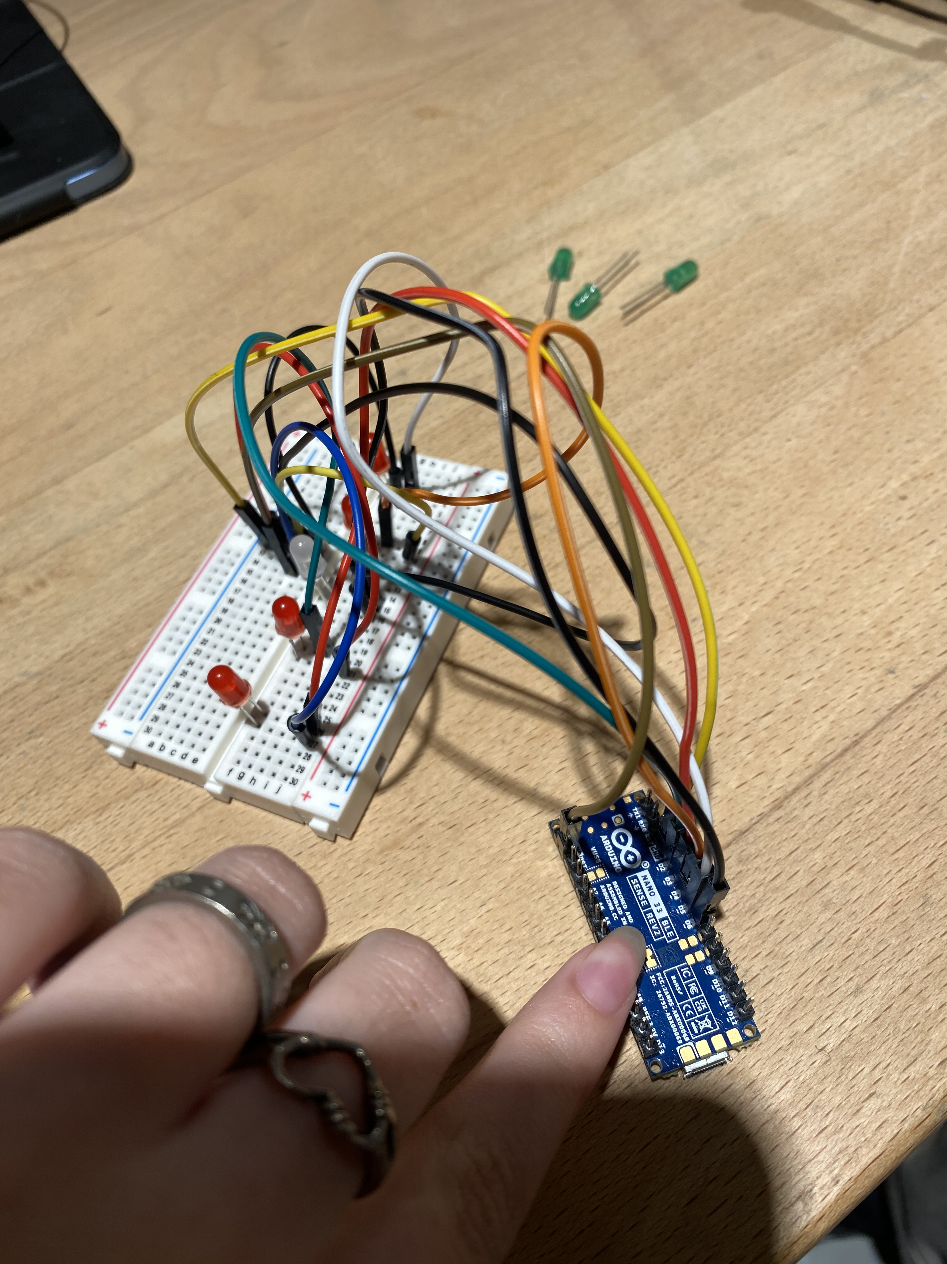
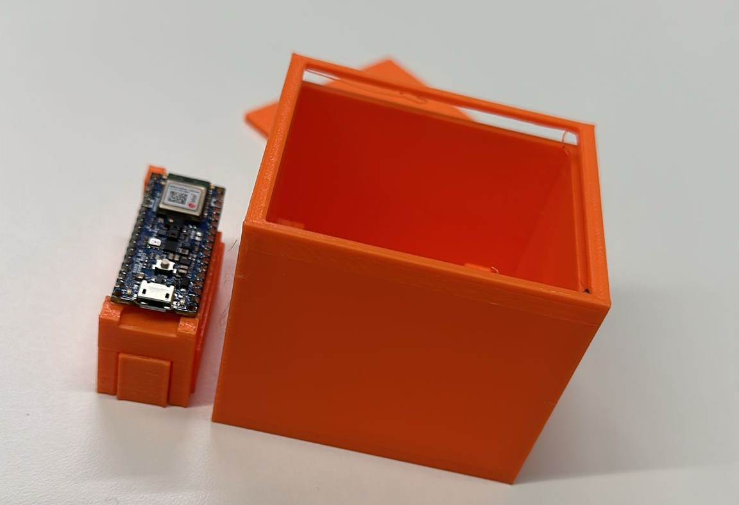
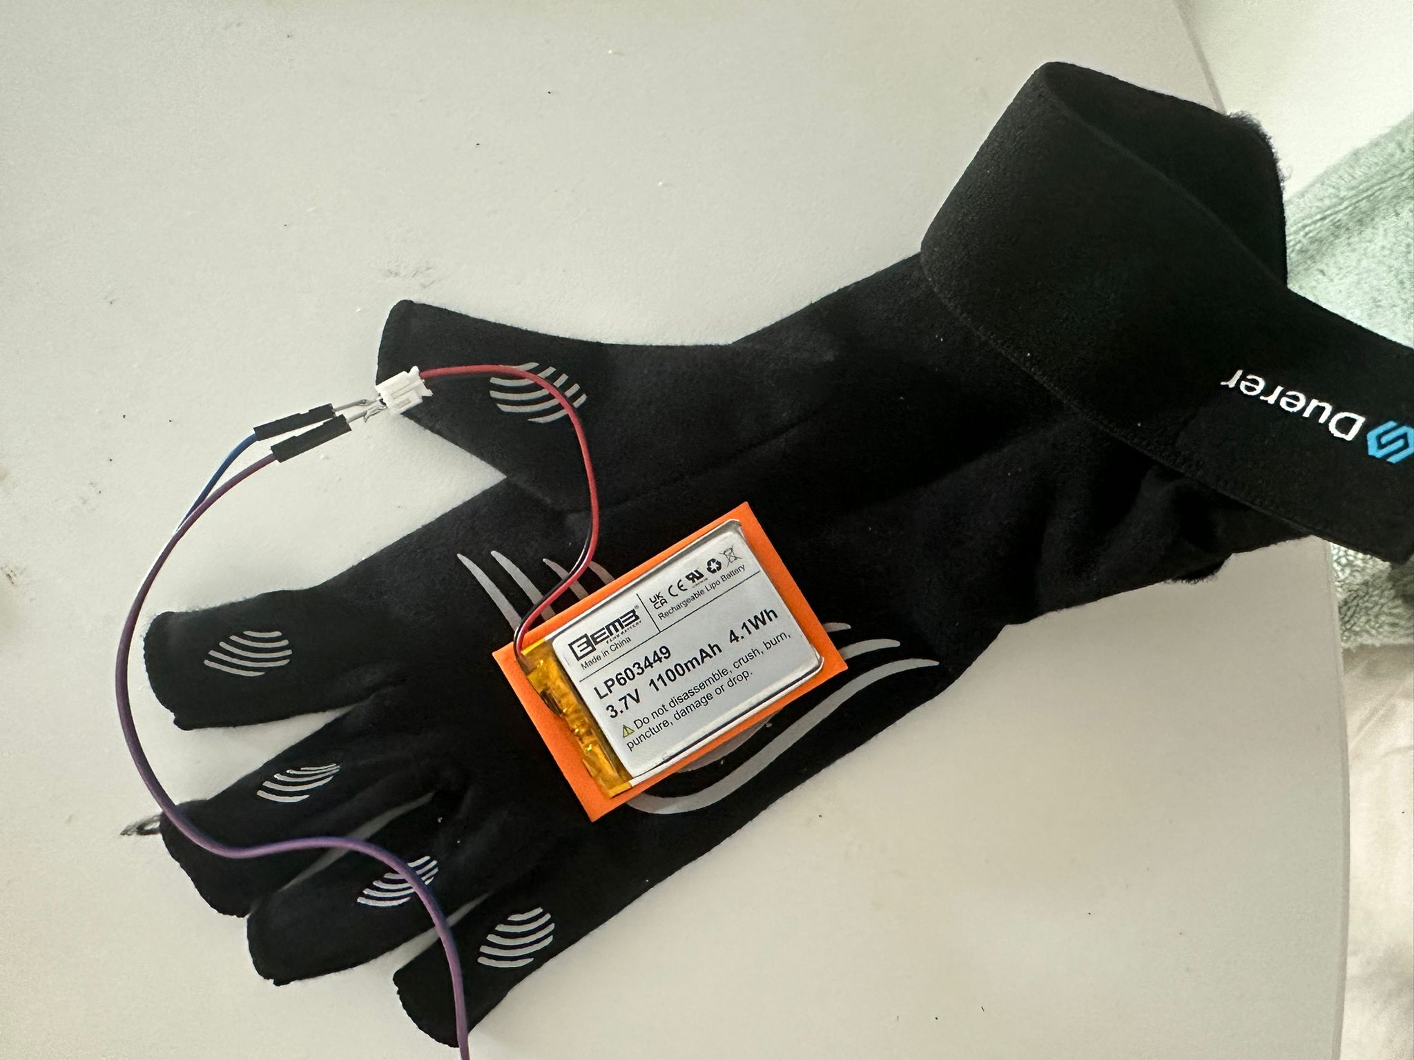
Hardware
Arduino® Nano 33 BLE Sense Rev2 with Headers
ELEGOO Electronic Fun Kit, Breadboard, Cable, Resistor, Capacitor, LED, for Electronics Learning Kit, Compatible with Arduino IDE
Tello Drone
Batteries and charging station for the drone
ADXL345 Module, Accelerometer*
APDS-9960 sensor for detected gestures*
3D printed case
Battery for the Sensor
Glove
Velcro Tape
*Unnecessary

Slide 5
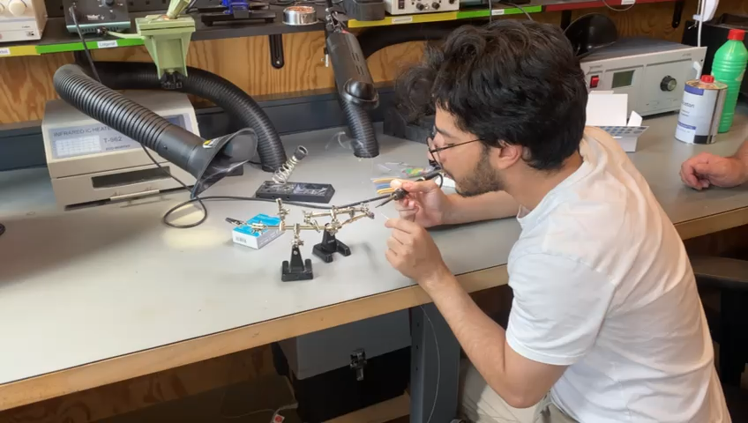
Some Redundant Work

Slide 6
Software
Arduino IDE
VS Code (or any IDE that supports Python)
Tello app (for drone recallibration during testing)

Slide 7
Methodologies

Slide 8
PID Control
Implement a PID controller to use the fused sensor data for stabilizing the drone
no need as we have a Tello drone, which already implements this

Slide 9
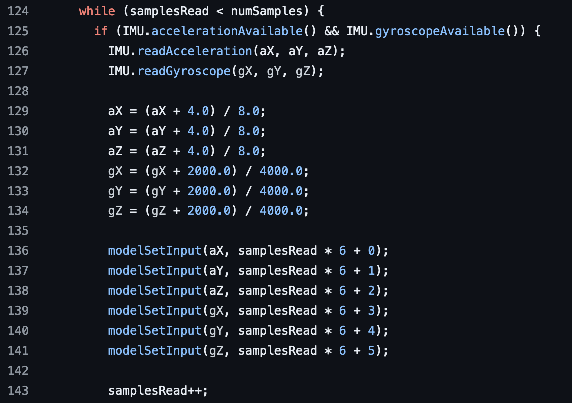
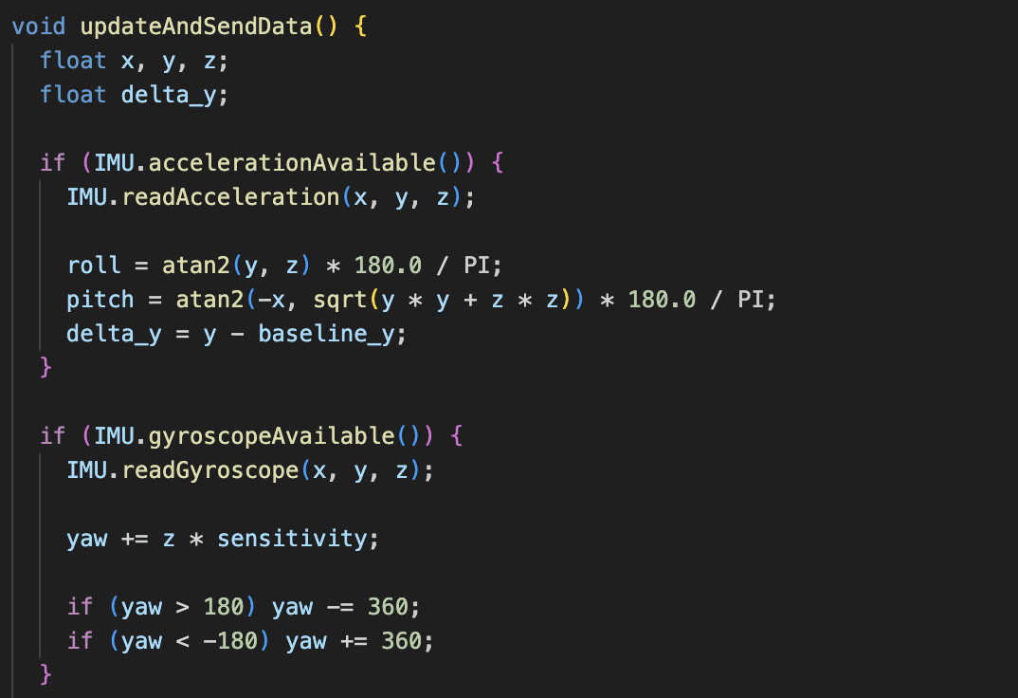
Sensor Fusion
Use existing libraries to handle sensor fusion for the 9-axis IMU
Magdwick algorithm useful for short term and long term correction
Downside of Magdwick: delay in change of motion
Solution idea: set a sensitivity variable
Outcome: values rise exponentially faster with
no regards of how much the hand is tilting
Mahony Filter
Values are accurate and they change in real
time according to the degree of the rotation of
the hand
Not the best in practice, long term starts drifting
Final Solution: calibrator

Slide 10
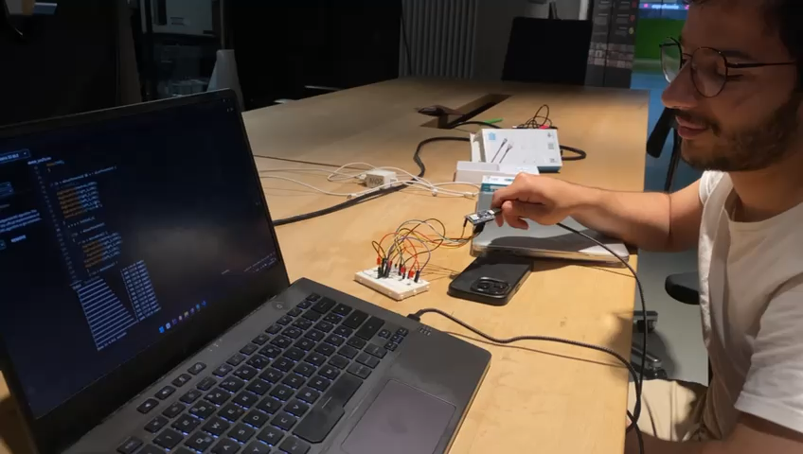
Values all over the place

Slide 11
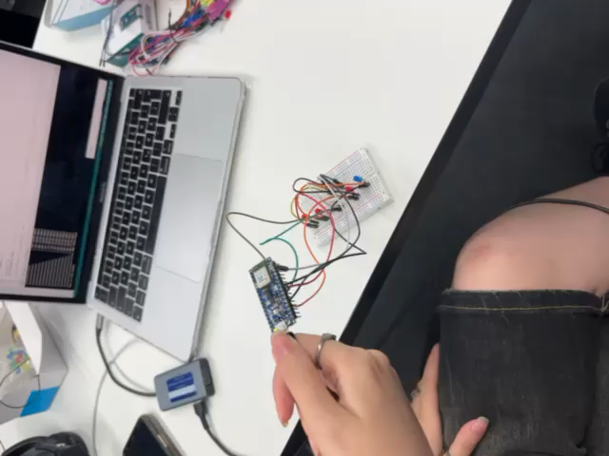
Improvements
TUM School of Computation, Information and Technology | Campus Heilbronn
11

Slide 12
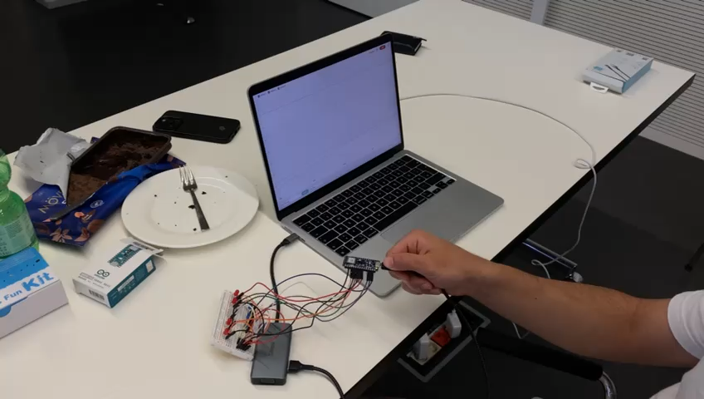
Serial Plotter

Slide 13
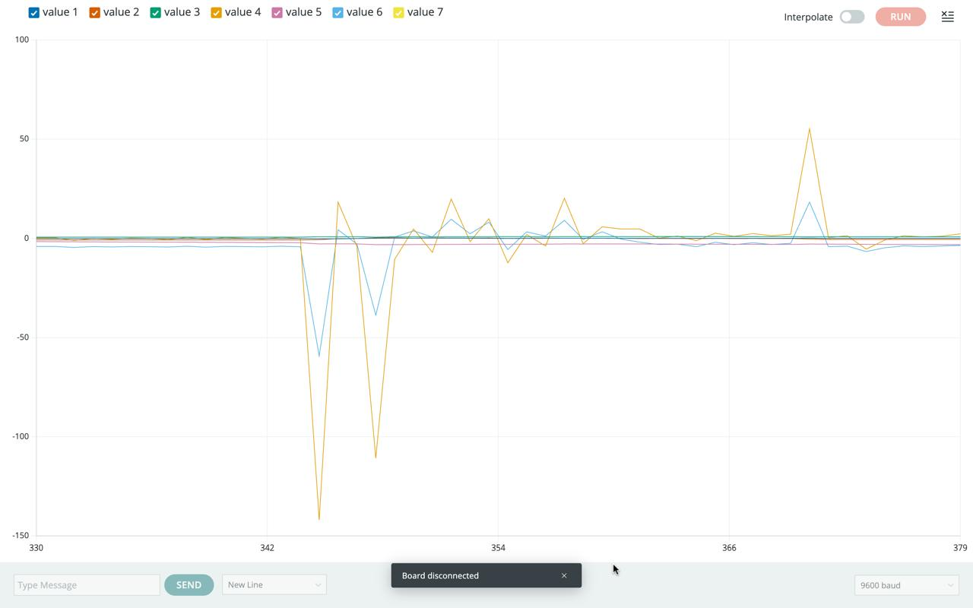

Slide 14
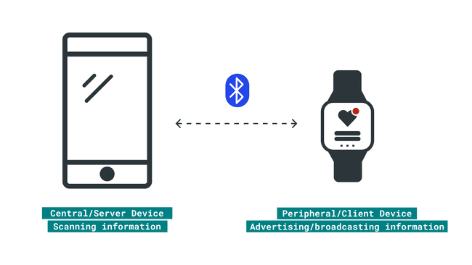
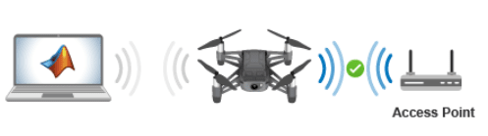
Bluetooth and Wi-Fi

Slide 15
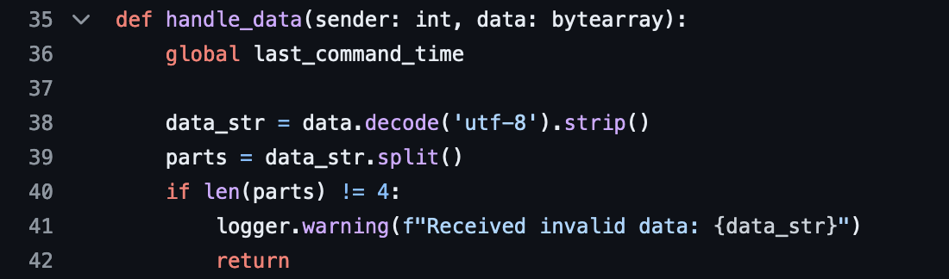
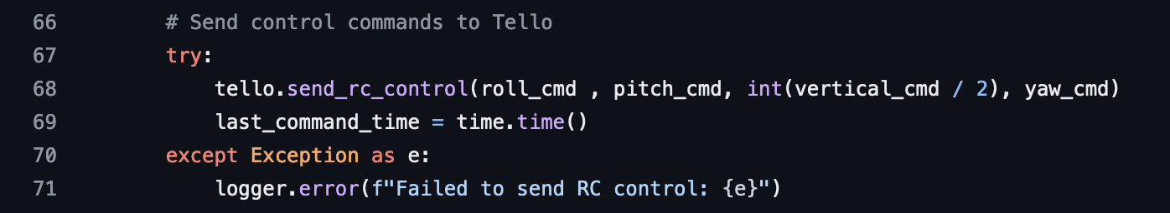
Values to Commands
Converting the values received from the sensor to commands the drone understands

Slide 16
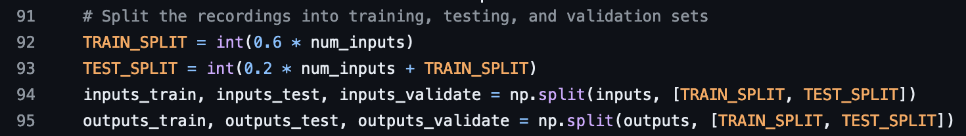
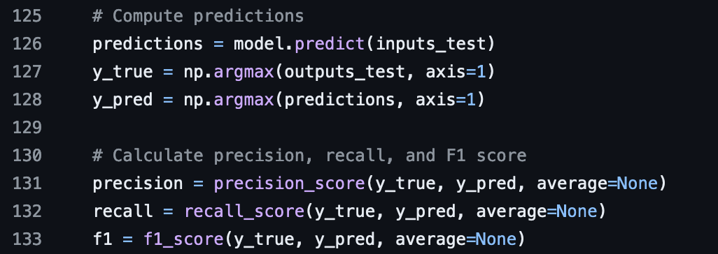
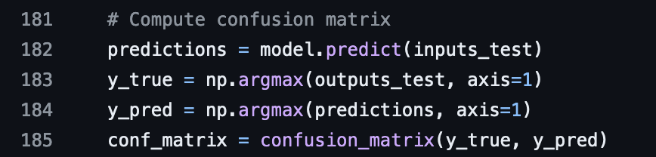
Model Training

Slide 17
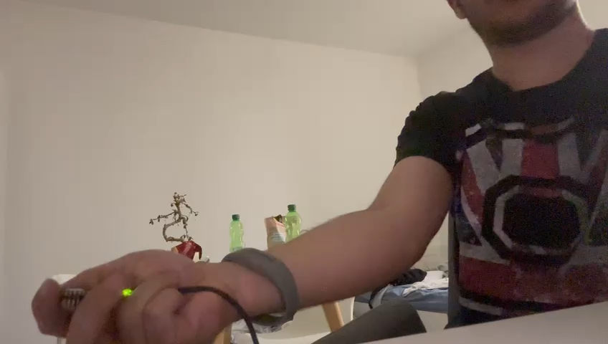
Model Training

Slide 18
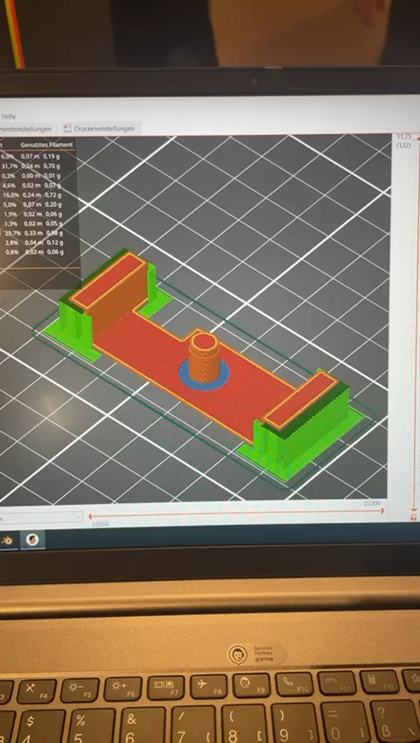
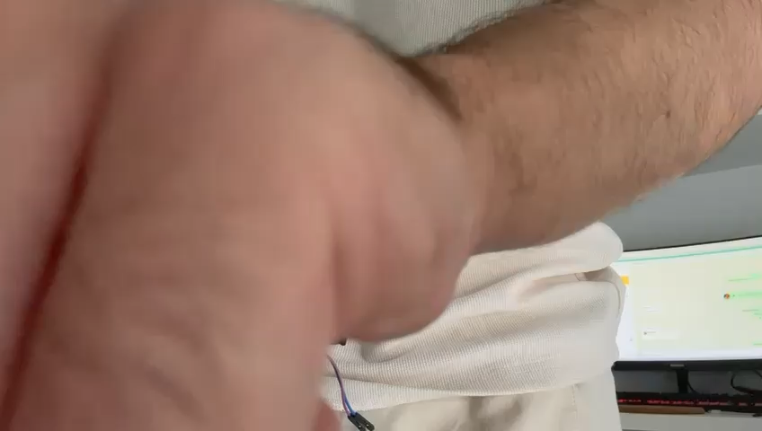
Physical Apperance
Print a 3D case for the Arduino (ready design to tweak from the internet)
5 LEDs to indicate the direction of the hand (optional)
Battery
Glove

Slide 19
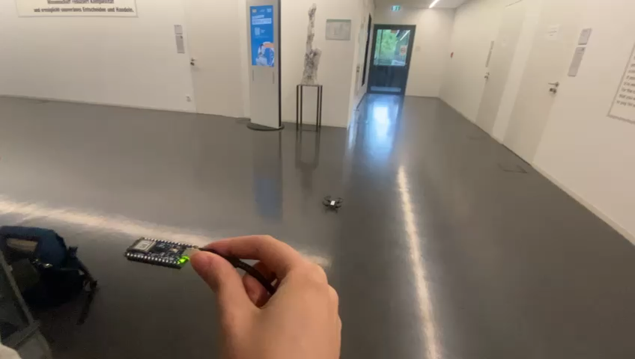
Testing

Slide 20
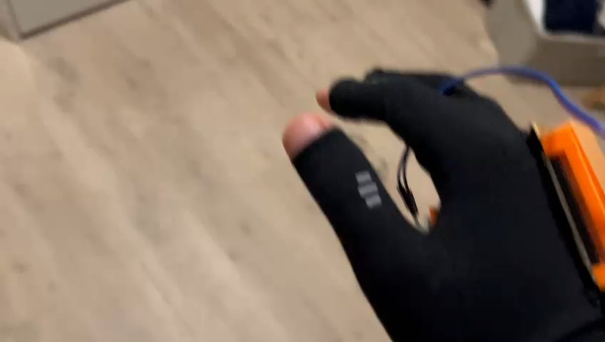

Slide 21
Final Demo Video

Slide 22
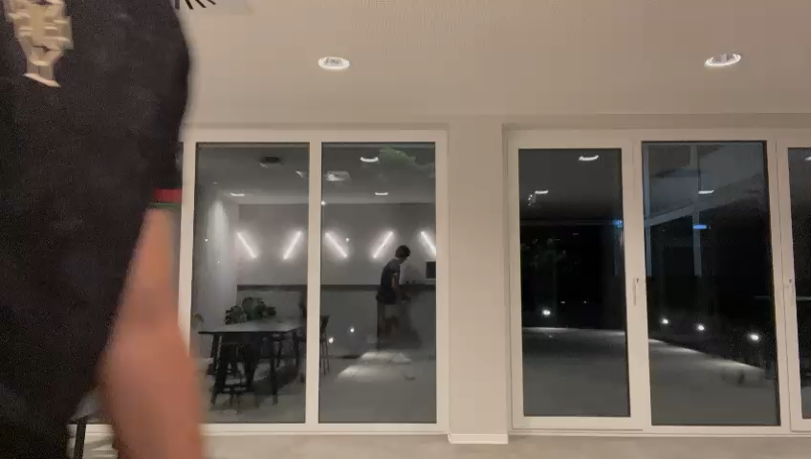

Slide 23
Conclusions

Slide 24
Findings
By combining multiple sensors and using sensor fusion techniques, we achieved a precise and responsive control system, ensuring accuracy and stability.
The project demonstrated the potential of wearable and portable technology, integrating Arduino Nano 33 BLE Sense with Bluetooth Low Energy (BLE) for effective control.
Hand gestures make drone control more accessible, lowering the barrier for users unfamiliar with the technology.
This study highlights the potential for user-friendly interfaces in robotics and embedded systems, and future advancements in human-machine interaction.
Find our GitHub here:
https://github.com/DaliGaoudi/DroneGestureControl

Slide 25
Refrences and Citations
https://github.com/kinivi/tello-gesture-control
https://docs.arduino.cc/
https://dl-cdn.ryzerobotics.com/downloads/Tello/Tello%20SDK%202.0%20User%20Guide.pdf
https://djitellopy.readthedocs.io/en/latest/tello/
https://docs.arduino.cc/tutorials/nano-33-ble-sense/ble-device-to-device/
https://github.com/hbldh/bleak/tree/develop
https://www.youtube.com/watch?v=hR1zRQ4YVQM
https://www.hackster.io/csoham/gesture-controlled-drone-part-1-bdf9d1
https://www.mdpi.com/1424-8220/23/5/2666
https://www.youtube.com/watch?v=hR1zRQ4YVQM
https://www.autodesk.com/products/fusion-360/personal
https://www.youtube.com/watch?v=zPKZQx0ZVxY
https://colab.research.google.com/drive/1Jj_LjUFtrzhLT6QaVmfLupGtPSITQi5Q#scrollTo=9J33uwpNtAku
https://www.mathworks.com/help/matlab/supportpkg/configureryze-tello-drones-using-the-setup-screen.html
https://www.ni.com/en/shop/labview/pid-theory-explained.html

Slide 26
Thank You!
Any questions?

